Slide 1

The Battle of Neighborhoods
Choose a Greater Toronto Area neighborhood to start business under the coronavirus pandemic in year 2020

Slide 2
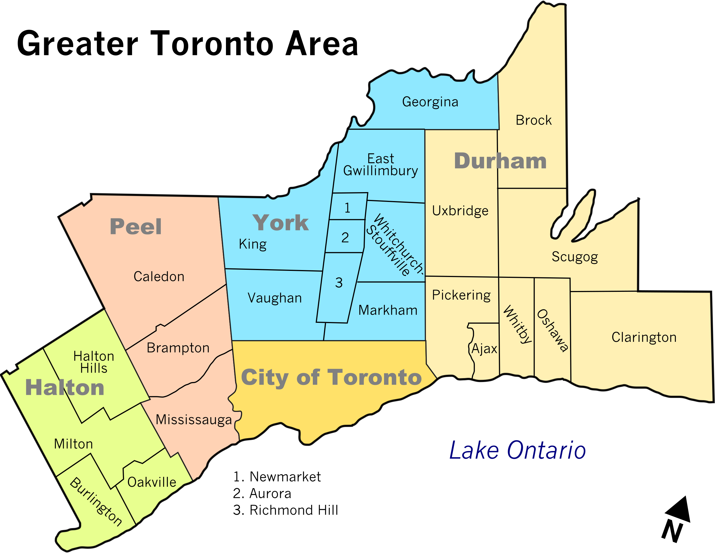
Introduction - Greater Toronto Area
6.5 million population
20% of Canada’s population
20% of Canada’s GDP
Around 6000 confirmed cases of COVID-19 in May, 2020

Slide 3
Our purposes
Choose a city in Greater Toronto Area has less cases of COVID-19
Analysis its neighborhood for new immigrants and business owners in 2020

Slide 4
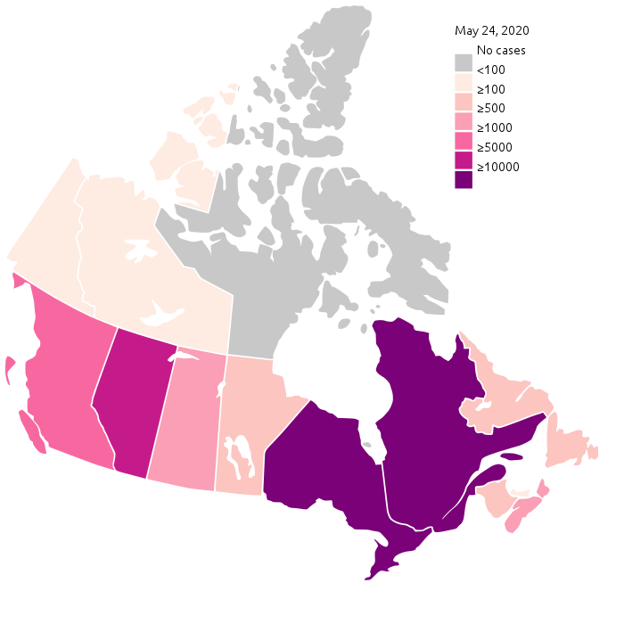
Coronavirus Pandemic in Canada

Slide 5
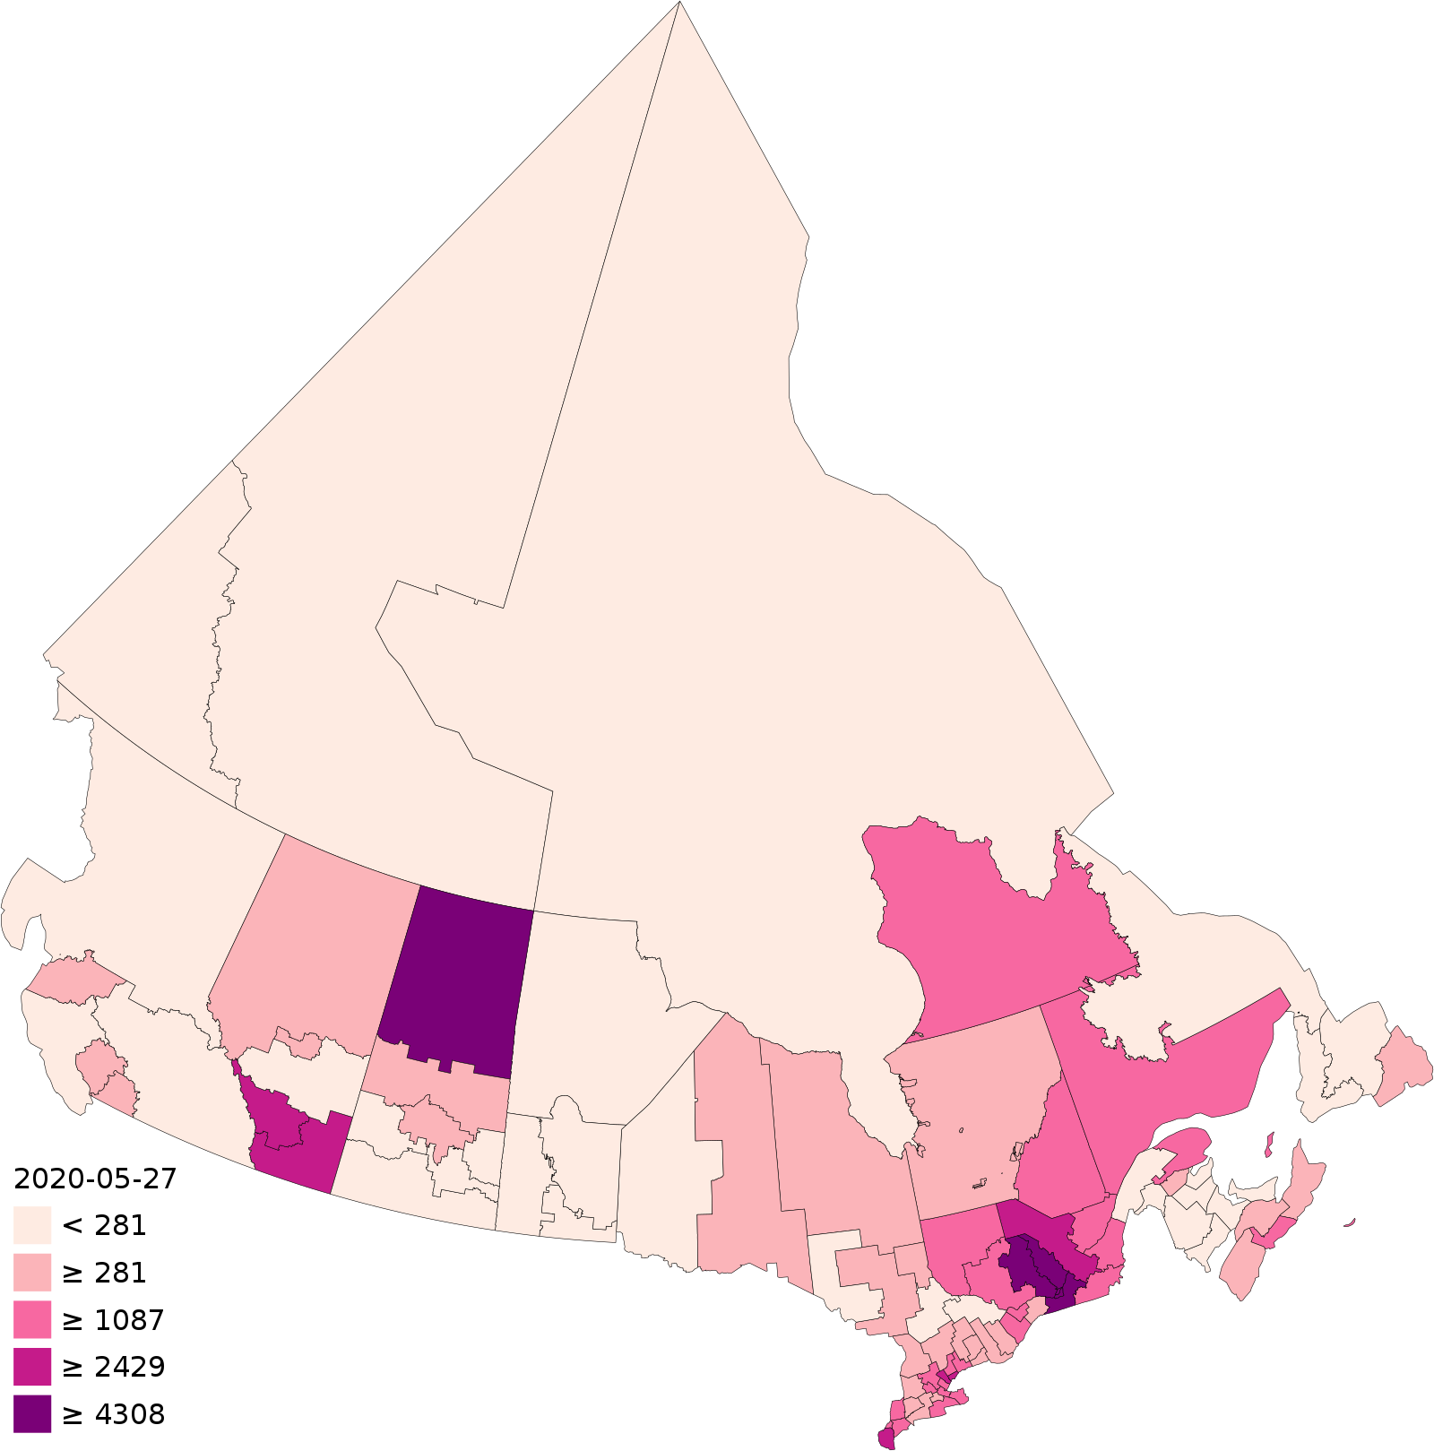
Coronavirus Pandemic in Ontario
Cases per million residents by health region
Greater Toronto Area

Slide 6
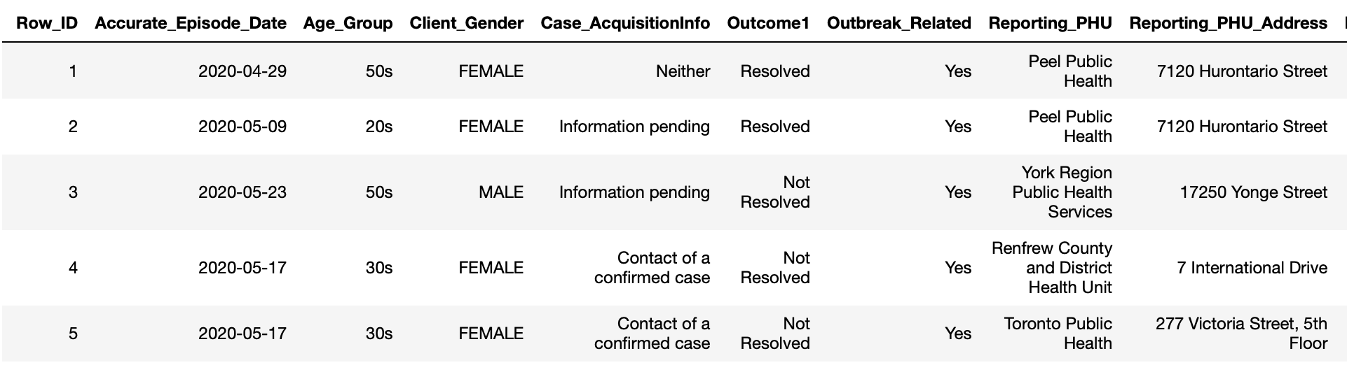
Data Process and Selection
Confirmed Positive Cases of COVID-19 in Ontario from https://data.ontario.ca/dataset/f4112442-bdc8-45d2-be3c-12efae72fb27/resource/455fd63b-603d-4608-8216-7d8647f43350/download/conposcovidloc.csv

Slide 7
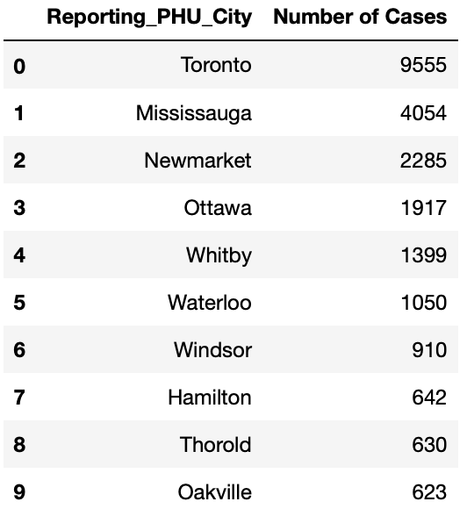
Top 10 cities in Ontario have the most confirmed coronavirus cases:
City we choose

Slide 8
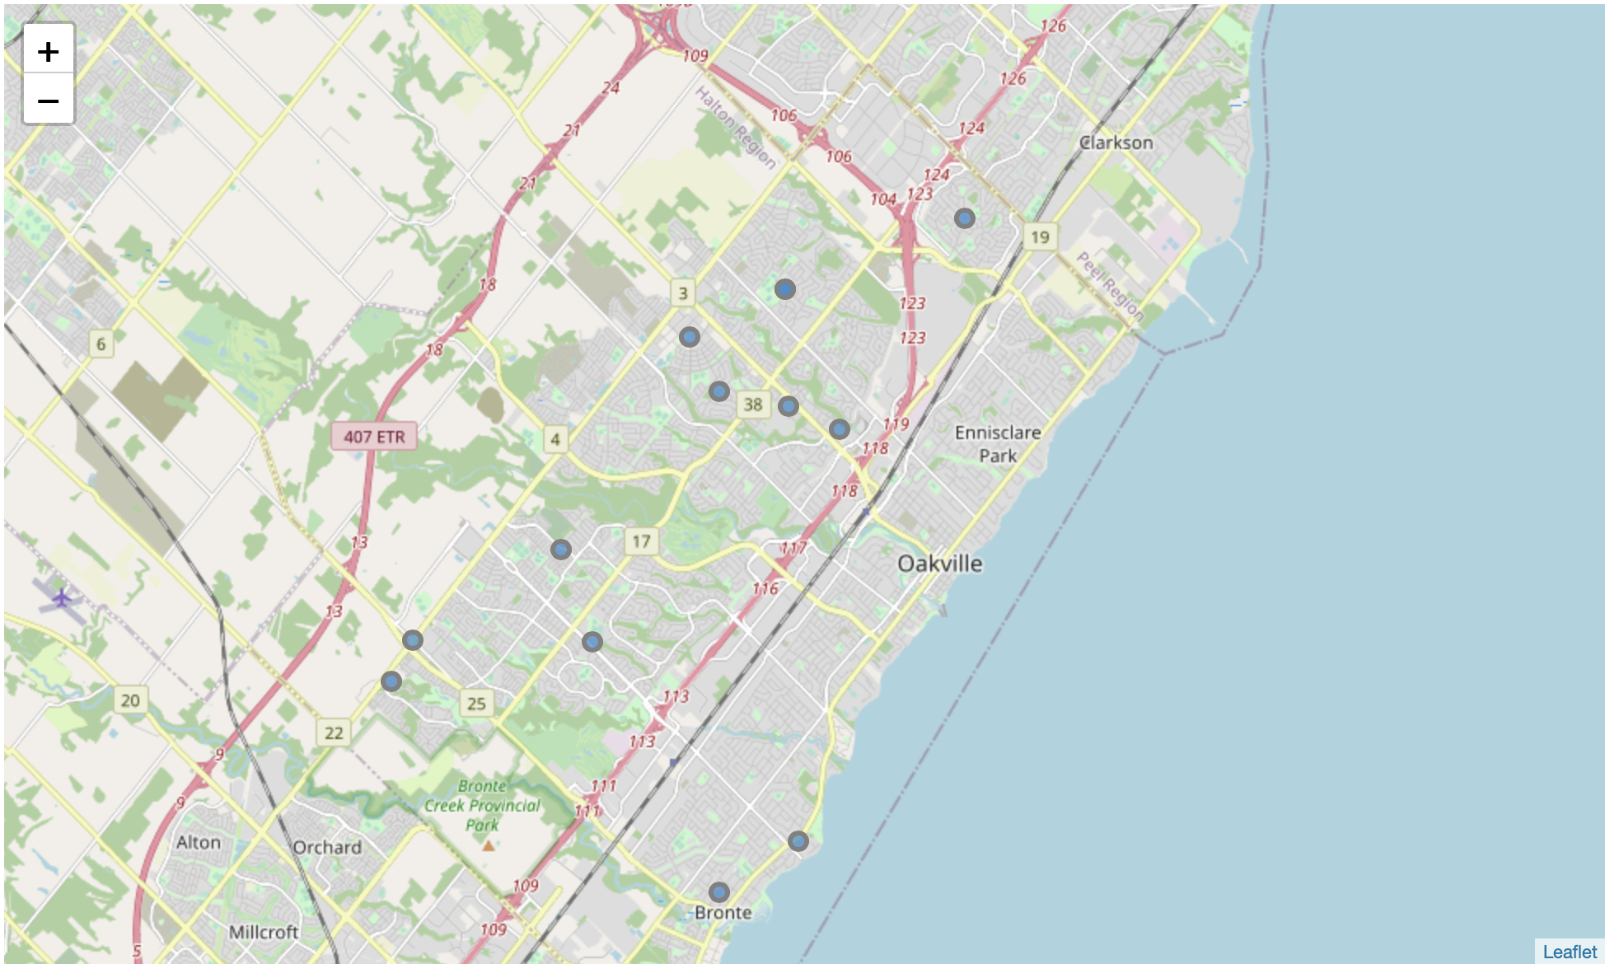
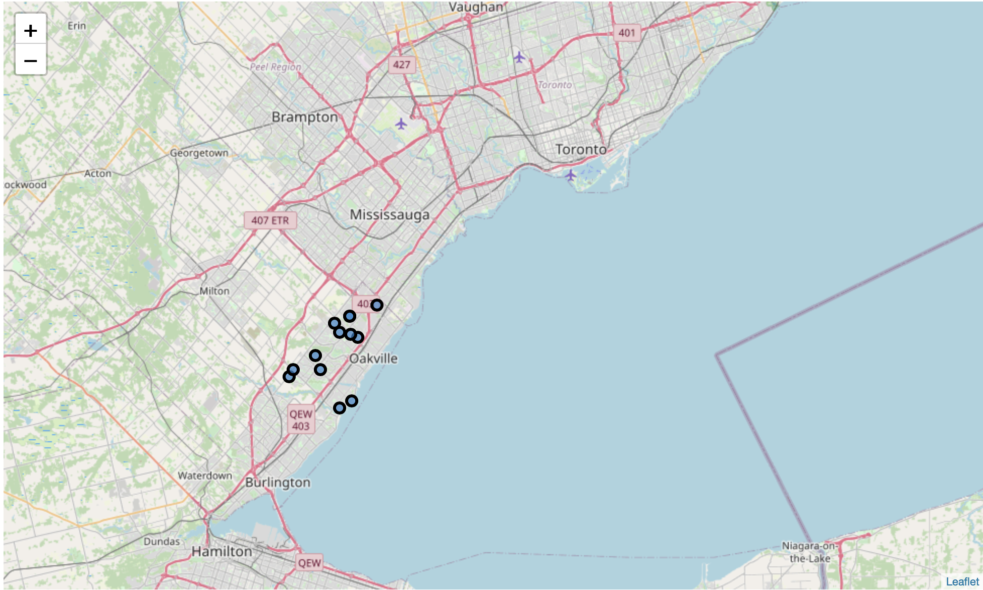
Neighborhoods in Oakville
Old Oakville
Kerr Village
Bronte
Eastlake
Clearview
College Park
Iroquois Ridge North
Iroquois Ridge South
Glen Abbey
Palermo
River Oaks
Uptown Core
West Oak Trails

Slide 9
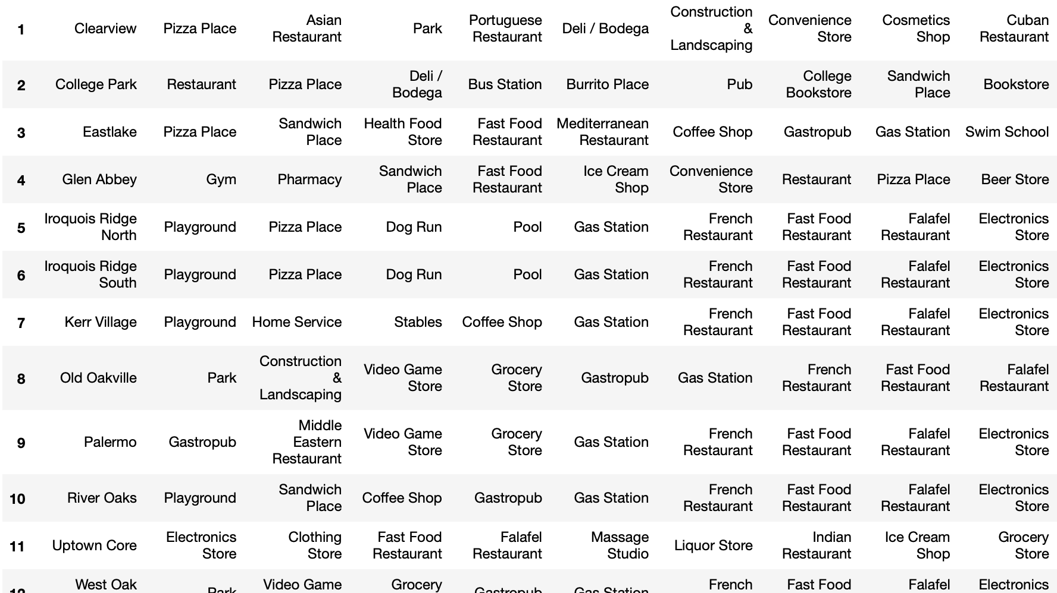
The Most Common Venue for Each Neighborhood

Slide 10
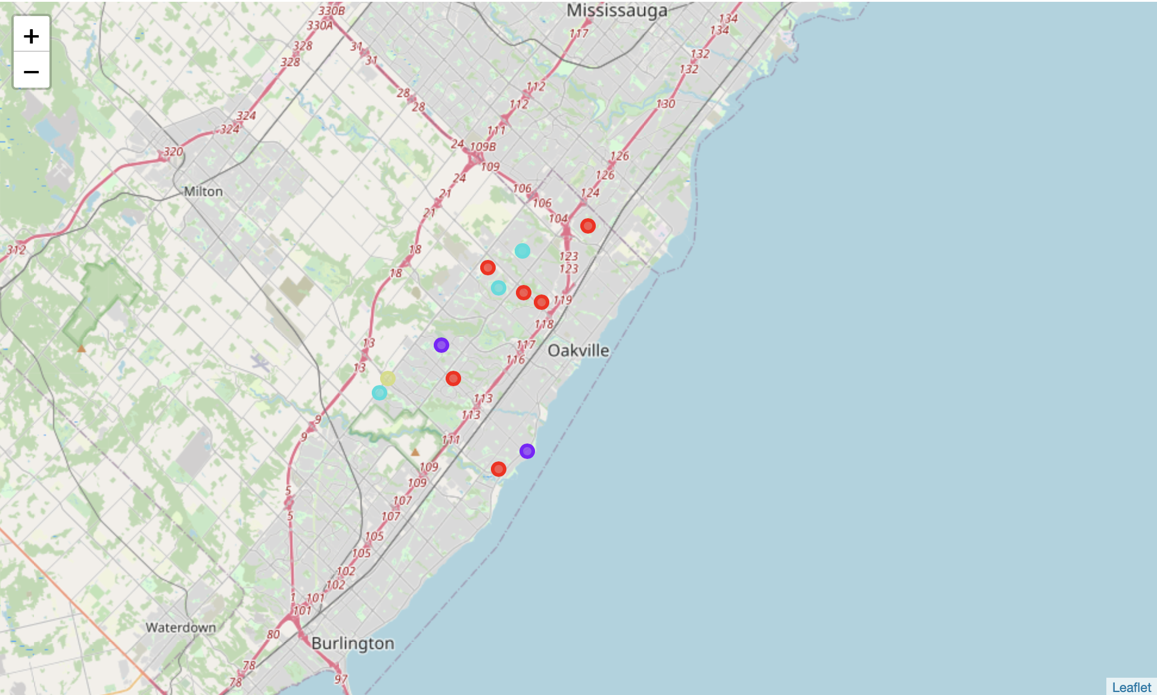
Cluster Analysis by K-Means Algorithm

Slide 11
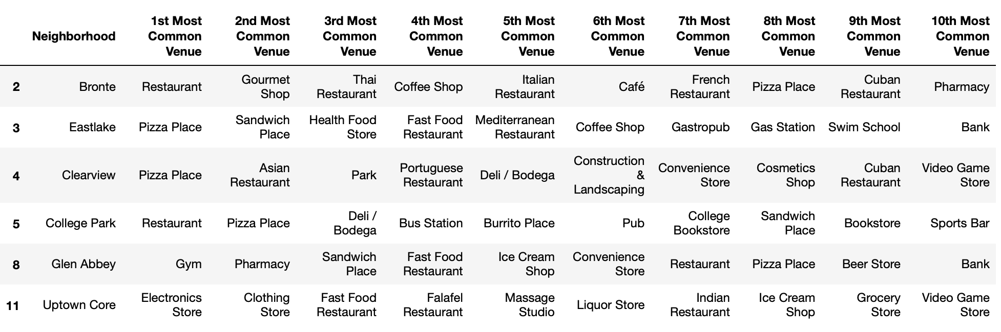
Results - Cluster 1
Cluster 1 is the biggest group with 6 of 13 neighborhoods.
The most common venues in this group are restaurants, fast food restaurants and stores.

Slide 12
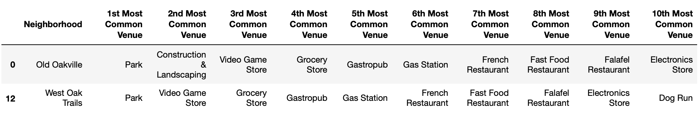
Results - Cluster 2
Cluster 2 has 2 of 13 neighborhoods in Oakville.
Park, Landscaping and Gas Station are more common in this neighborhood.

Slide 13
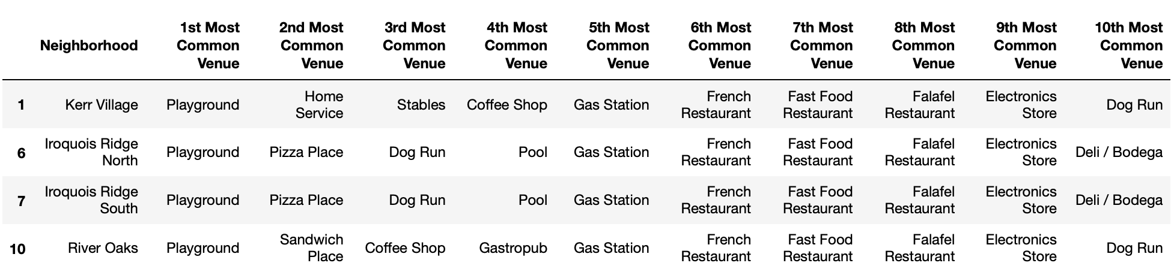
Results - Cluster 3
Cluster 3 has 4 of 13 neighborhoods in Oakville.
These neighborhoods have more entertainment facilities, such as park, swimming pool and playground.

Slide 14
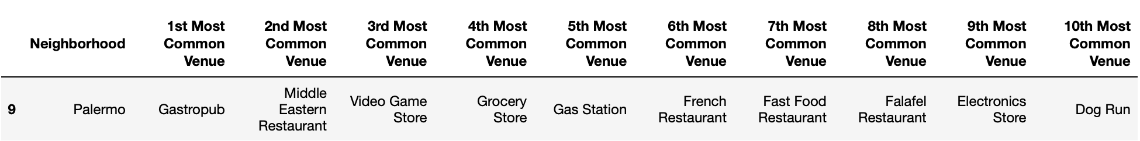
Results - Cluster 4
Cluster 4 only has one neighborhood.
Pubs are popular than restaurants in here, and there is few outdoor facilities.

